Slide 1
Administrative Details
Next week’s quiz
  The syllabus listed the first quiz as September 27. This is now corrected. It really is on September 22, 12:30pm sharp
  If you want to fill out the quiz on paper, please vote online
Quiz format and rules
  ~15 Multiple choice style questions, ~20 mins
  Covers lecture material from September 8, 13, and 15
  No reference material (including cheatsheets, books, phones, etc.)
  Laptop users: Typing and/or non-owl tabs are obvious indications of cheating. Mouse clicks only
  When you finish, please slip out quietly

Slide 2
Administrative Details
Assignment 1
  Should be posted tomorrow. You should already be able to do Part 1. Depending on how far we get in the material today, you should be able to do Part 2 as well. Part 3 material will come next week
  Due October 7 (3 weeks)

Slide 3
Diagramming software
Useful tool for assignment 1 and 2
MS Visio - Need your DreamSpark Premium Account/Password (should be free from the University)
Alternate tools
  https://en.wikipedia.org/wiki/Diagramming_software
  A pencil and paper – Available anywhere fine scholarly supplies are sold
CS3319

Slide 4
Follow-up on weak entity types
Recall from slide 32, a “key” attribute is any attribute that uniquely identifies an entity. In other words, no two entities can have the same value in a key attribute
  Usually this is an attribute like ___ID or ___NUMBER, but any attribute that fits the uniqueness criteria counts
Recall from slide 44, weak entities have no key attribute of their own. They don’t exist unless they are “tied” to their identifying owner
  Why don’t they have a key? They don’t need one. They are tied closely enough to their identifying owner that they essentially use their owner’s key

Slide 5
Follow-up on weak entity types
Recall from slide 44 that weak entity types might sometimes “feel” like a composite/multi-valued attribute
Recall from slide 44 that their relationship with their identifying owner is represented with the double diamond.
  Therefore, if you have an ER diagram with a weak entity (double rectangle) but no weak relationship (double diamond), you have a problem!
If the database you are designing only keeps track of these entities because of a relationship with another entity you really want to keep track of, then you probably want to make it a weak entity type
  Eg. Employee HAS Dependents in a “Company” database

Slide 6
Follow-up on (min, max)
Typically, an ER diagram would use either the cardinality/single-line/double-line notation OR (max, min) but not both
For the purposes of this course, we will often use both just to help ensure we are designing our database properly
The two formats convey the same information:
Doctor
1
Treats
N
Patient
Doctor
Treats
Patient
(0, N)
(1, 1)

Slide 7
Follow-up on ER diagrams
There is no “right answer” to a design. Allow room for interpretation.
Typically, an ER diagram is something a team of developers and DBAs build and discuss together

Slide 8
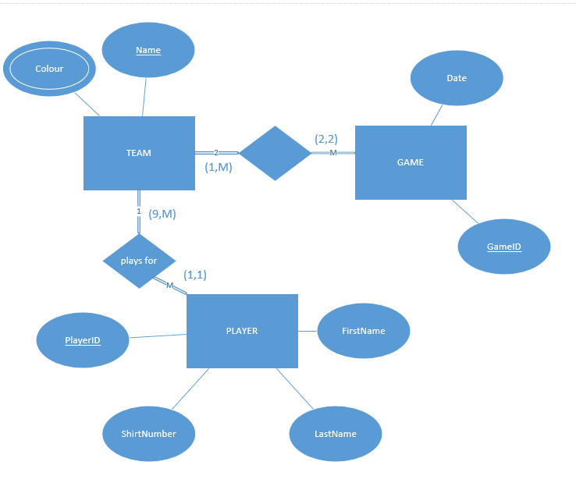
Warm Up Question
Draw an ER diagram for a baseball league. The league has teams, games and players. Keep track of the players first name, last name, shirt number and player id. We only keep track of players who are on teams. Each team must have at least 9 players. Each team will have a unique name and team colours. Each game has a date the game is schedule for, think carefully about where to store the score!
score
CS3319

